Slide 1
Add Chapter
String， IDE and debug
Dai Liyun
dailiyun@swu.edu.cn

Slide 2
string
#include <string>
#include<iostream>
using namespace std;
int main()
{
string day;
day = "Monday";
string name;
cin>>name;
return 0;
}

Slide 3
operator concatenates
string mon=“Monday”；
string tun=“Tuesday”;
string catstr=mon+tun;
cout<<catstr;
catstr=mon+” “+tun;
cout<<catstr;

Slide 4
operator concatenates
string mon=“Monday”；
string tun=“Tuesday”;
string catstr=mon+tun;
cout<<catstr;
catstr=mon+” “+tun;
cout<<catstr;
Display MondayTuesday
Display Monday Tuesday

Slide 5
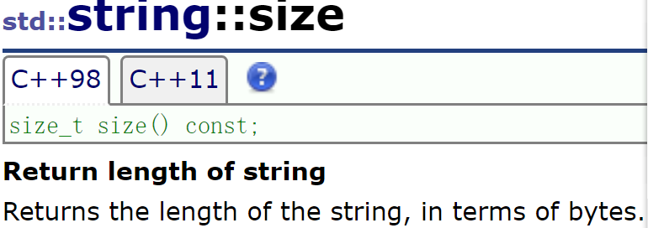
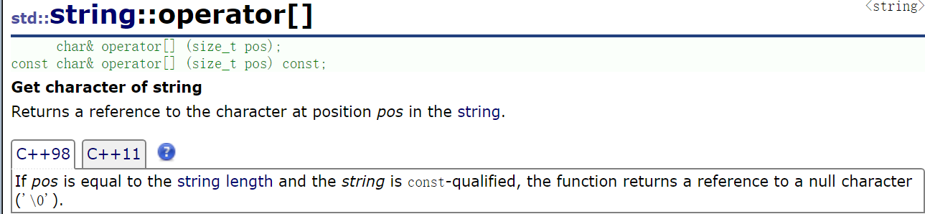
Common functions of string
std::string str ("Test string");
for (int i=0; i<str.size(); ++i)
{
std::cout << str[i];
}

Slide 6
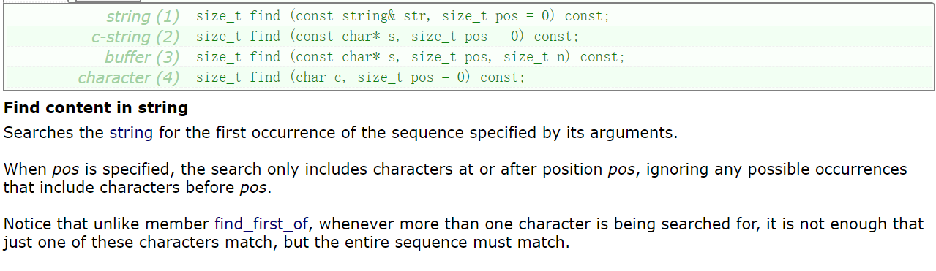
find function of string
std::string str ("There are two needles in this haystack with needles.");
std::string str2 ("needle");
// different member versions of find in the same order as above:
std::size_t found = str.find(str2);
if (found>-1)
std::cout << "first 'needle' found at: " << found << '\n';

Slide 7
More functions (string)
http://www.cplusplus.com/reference/string/string/?kw=string

Slide 8
Exercise
Register an account on site http://47.95.215.87/
User name xuehao-name e.g. 20170901-代立云
Click Contests menu
Click contests “2019 C++ class“
Password 913608
Select problems list.
Do „计算句子中单词的数量”

Slide 9

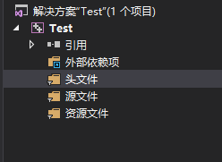
VS Porject Struture
Header files (.h)
Source files (.cpp)

Slide 10
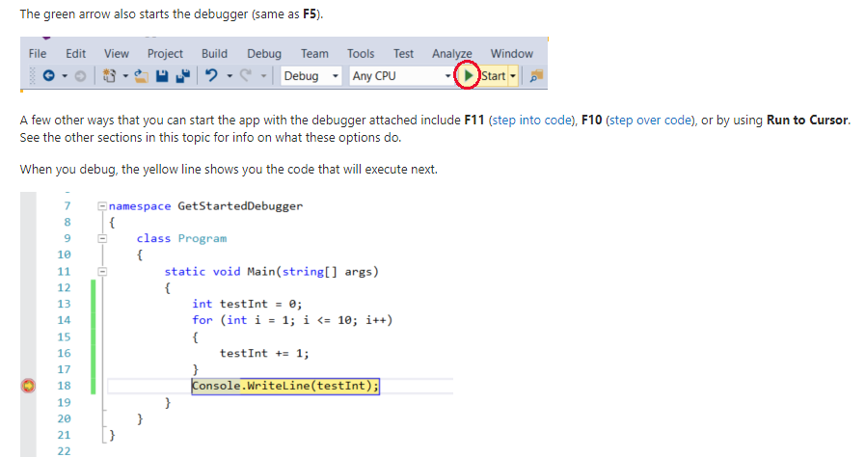
Debug F5 Start debug mode
Set breakpoint

Slide 11
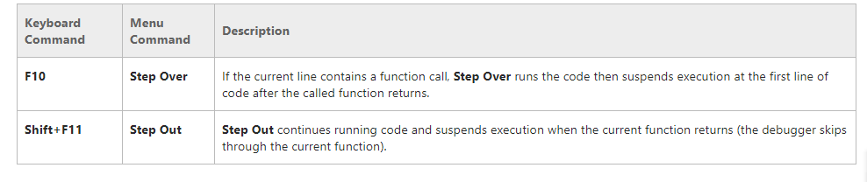
Debug shortKey
F11 | Step in | Step in the call function

